Slide 1

FSHARPING v HPE
Úvod do světa F# (pohledem C# vývojáře)
Roman Provazník
@dzoukr
www.fsharping.cz
@fsharping

Slide 2



Slide 3


Slide 4
www.fsharping.cz

Slide 5

F#

Slide 6


Don Syme

Slide 7
Multi-paradigm
Statically typed
OCaml syntax

Slide 8




Slide 9


F#
C#

Slide 10




Slide 11




Slide 12



Community

Slide 14
The Power of F#

Slide 15
Type inference

Slide 16


Slide 17
Immutability

Slide 18
Immutability is overrated,
but no one will change it

Slide 19
Easy to test

Slide 20
Hard to screw

Slide 21
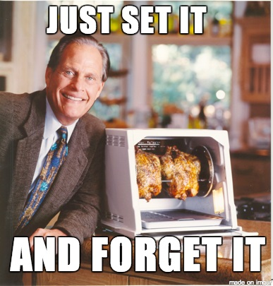

Slide 22
No NULL

Slide 23
Clean code

Slide 24
C#
{{{{{{{{;;;code;;;; }}}}}}}}

Slide 25
F#
code

Slide 26
Less code = Less noise

Slide 27
Less code = Less names

Slide 28
StatelessDataSourceRollbackFactory
AbstractDefaultJavaModelProxy
InternalNamespaceSelectionSingleton

Slide 29
189 projects in solution
9350+ classes
1140 TODOs in code

Slide 30


Slide 31
Naming is HARD

Slide 32
The length of a name should be related to the length of scope

Slide 33
Anonymous functions

Slide 34

Combine all paradigms!

Slide 35
OOP + FP = faster learn

Slide 36
REPL

Slide 37
Read-Evaluate-Print Loop

Slide 38
Use debugger only for bugs

Slide 39
Faster development

Slide 40


Slide 41
$$$

Slide 42
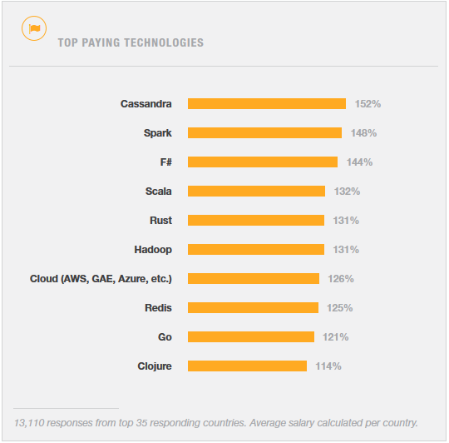
http://stackoverflow.com/research/developer-survey-2015

Slide 43
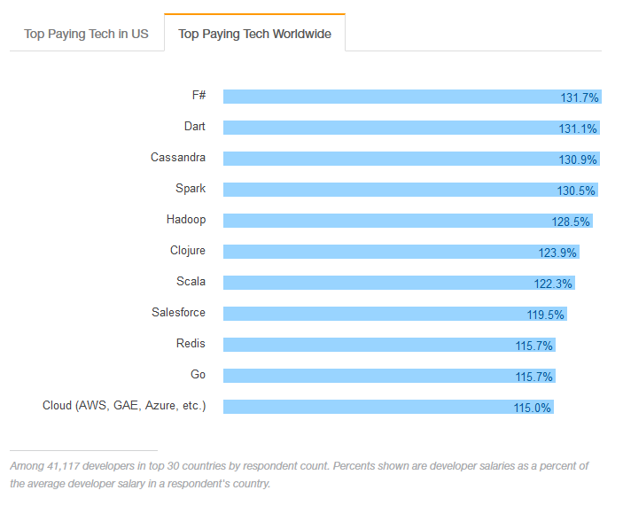
http://stackoverflow.com/research/developer-survey-2016#technology-top-paying-tech

Slide 44
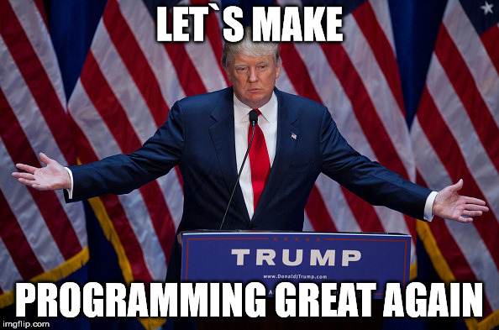

Slide 45
Let`s start with F#

Slide 46
.fs vs .fsx

Slide 47
module vs namespace

Slide 48

Babica rule

Slide 49

If you don`t know, use module

Slide 50
DEMO #1 Simple function

Slide 51

F# cool features

Slide 52
Tuple

Slide 53
Data structure with N elements

Slide 54
Ideal as lightweight function return value

Slide 55
("Answer to unknown question", 42)

Slide 56
DEMO #2 Tuples

Slide 57
Lists

Slide 58
F# list <> .NET List class

Slide 59
Immutable by default

Slide 60
Essential type for FP

Slide 61
DEMO #3 Lists

Slide 62
Functions

Slide 63
First-class citizen

Slide 64
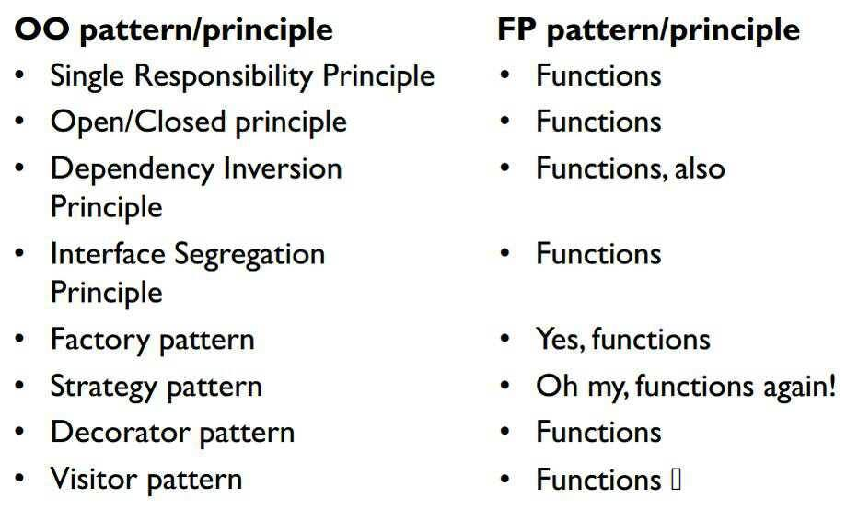
http://blog.cleancoder.com/uncle-bob/2014/11/24/FPvsOO.html

Slide 65
DEMO #4 Functions

Slide 66
Option

Slide 67
Do you remember NULL?

Slide 69
Use Option

Slide 70
Some(value)

Slide 71
None

Slide 72
Nothing else

Slide 74
DEMO #5 Options

Slide 75
Pattern Matching

Slide 76
Best. Thing. Ever.

Slide 77
SWITCH (on heavy drugs)

Slide 78
Is everywhere in F#

Slide 79
DEMO #6 Pattern Matching

Slide 80
Discriminated Unions

Slide 81
Another essential type

Slide 82
Pattern Matching Support

Slide 83
Enum (on even heavier drugs)

Slide 84
Value that can be exactly one case

Slide 85
DEMO #7 Discriminated Unions

Slide 86
Records

Slide 87
Great for grouping data into structured format

Slide 88
Immutable by default

Slide 89
But easy to clone

Slide 90
Cannot be inherited

Slide 91
Structural comparison and equality

Slide 92
Pattern Matching Support

Slide 93
“.” notation access

Slide 94
DEMO #8 Records

Slide 95
Unit

Slide 96
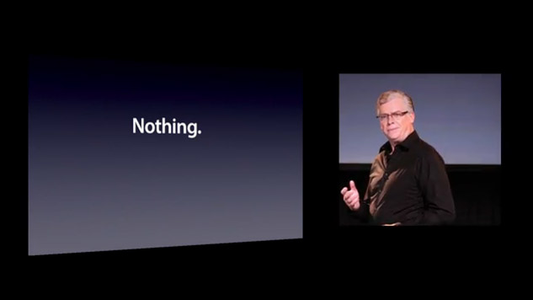

Slide 97
()

Slide 98
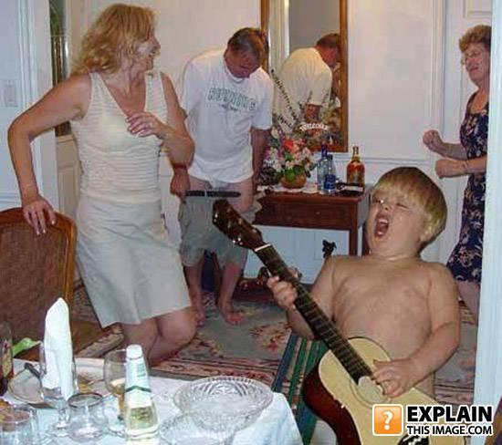
Even cooler features

Slide 99
Operators

Slide 100
|>

Slide 101
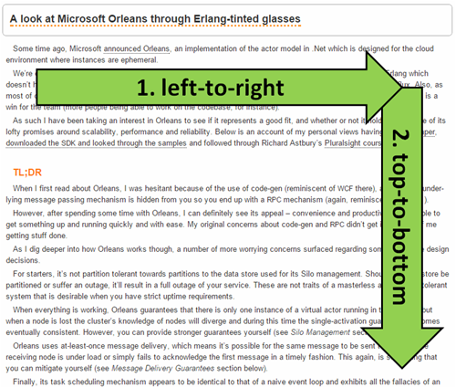
http://theburningmonk.com/2014/12/being-visually-honest-with-f/

Slide 102
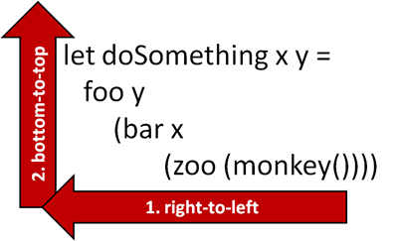
http://theburningmonk.com/2014/12/being-visually-honest-with-f/

Slide 103
|>

Slide 104
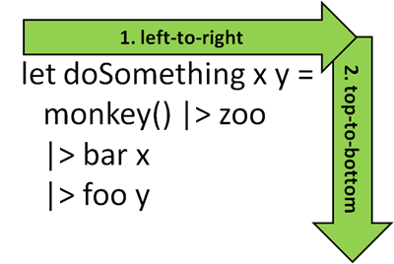
http://theburningmonk.com/2014/12/being-visually-honest-with-f/

Slide 105
<|

Slide 106
Function composition

Slide 107
>>

Slide 108
f(a) -> b >> f(b) -> c

Slide 109
f(a) -> c

Slide 110
<<

Slide 111
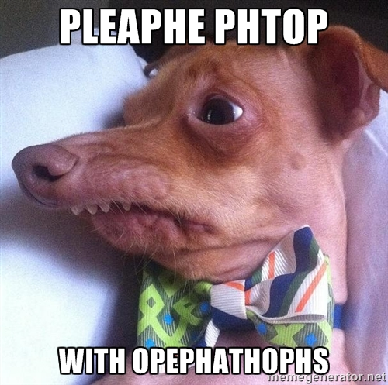

Slide 112
DEMO #9 Operators

Slide 113
Partial Function Application

Slide 114
Don`t use tuples as input parameters

Slide 115
Currying

Slide 116
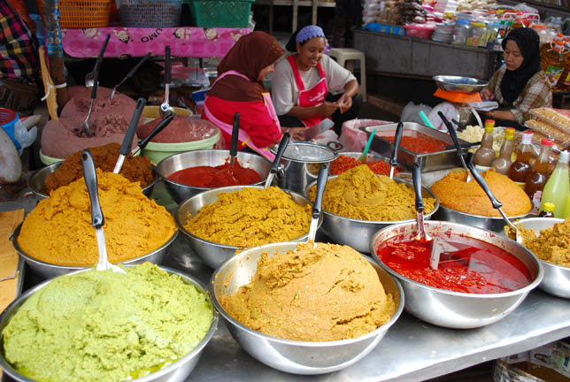

Slide 117
Transformation of function with N parameters into chain of N functions with 1 parameter

Slide 118
DEMO #10 Partial Function Application

Slide 119
Summary

Slide 120
F# is COOL!

Slide 121
Pattern Matching
Type inference
Immutability
Operators
Functions
Records
Discriminated Unions
no NULL

Slide 122
…and much more!

Slide 123
Thank you!

Slide 124
Please fill in
fsharping.cz/feedback
Úvod do světa F# (pohledem C# vývojáře)
Roman Provazník
@dzoukr
www.fsharping.cz
@fsharping

